Slide 1

Predicting Heart Attacks Using Patient Data
Filipp Krasovsky, Rudy Fasano
University of San Diego
MS Data Science 503 – Applied Predictive Modeling
June 2021

Slide 2
Problem Statement & KPI
Given a patient’s age, sex, resting blood sugar, cholesterol, chest pain information, etc, is a patient more likely than not to experience/have experienced a heart attack?
Objective: Maximize rate of true positives and true negatives.

Slide 3
Considered Solutions
Proximity Based Measures (KNN, NSC)
Hyperdimensional Separation (SVM)
Ensemble Learning (RF,GBT)
Logistic Regression (GLM)
Neural Network

Slide 4
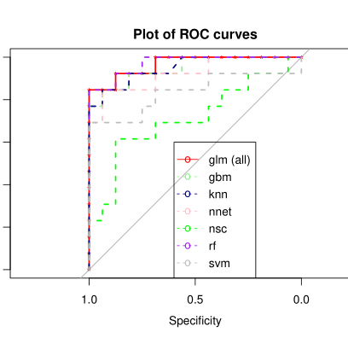
Performance/ Selection
Top two candidates: RF/Ensemble Learning and Logistic Regression
Random Forest selected despite higher complexity due to better accuracy.

Slide 5
Concluding Remarks
Demonstrated feasible solution to data challenge
Created analytics deliverable with practical implementation in a healthcare environment

